Slide 1
Credit Card Default Prediction
Domain: Banking
Technologies: Machine Learning

Slide 2
About Dataset
Variables
There are 25 variable’s: ID: ID of each client
LIMIT_BAL: Amount of given credit in NT dollars (includes individual and family/supplementary credit
SEX: Gender (1=male, 2=female)
EDUCATION: (1=graduate school, 2=university, 3=high school, 4=others, 5=unknown, 6=unknown)
MARRIAGE: Marital status (1=married, 2=single, 3=others)
AGE: Age in years
PAY_0: Repayment status in September, 2005 (-1=pay duly, 1=payment delay for one month, 2=payment delay for two months, ... 8=payment delay for eight months, 9=payment delay for nine months and above)
PAY_2- PAY_6:Repayment status in August - April 2005 (scale same as above)
BILL_AMT1- BILL_AMT6 : Amount of bill statement in September, 2005 (NT dollar)-April,2005
PAY_AMT1- PAY_AMT6 : Amount of previous payment in September, 2005 (NT dollar)-April,2005
default.payment.next.month: Default payment (1=yes, 0=no)
Dataset Information
This dataset contains information on default payments, demographic factors, credit data, history of payment, and bill statements of credit card clients in Taiwan from April 2005 to September 2005.

Slide 3
EDA
There are 30,000 distinct credit card clients.
The average value for the amount of credit card limit is 166,808.The standard deviation ,i.e,max value being 500,000.
Education Level is mostly graduate school and university.
Larger pool of credit card users are single in the given data set
Average age is 35.5 years, with a standard deviation of 9.09
As the value 0 for default payment means 'not default' and value 1 means 'default', the mean of 0.221 means that there are 22.1% of credit card contracts that will default next month .

Slide 4
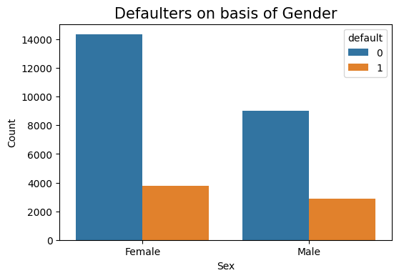
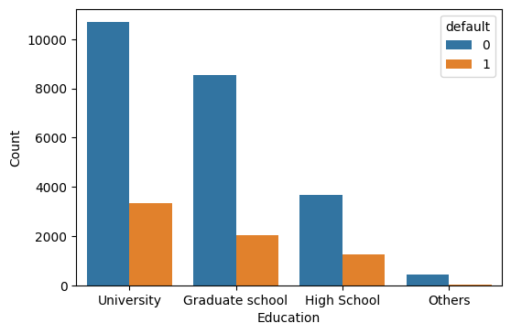
From the plotting of Default column we observed that the number of defaulters is comparatively less. Other observations are as follows:
There is more number of Females using credit cards but the default ratio between the female and male credit defaulters are negligible.
The graph shows that the number of defaulters among the University is higher as compare to rest of the graduates and high schoolers.

Slide 5
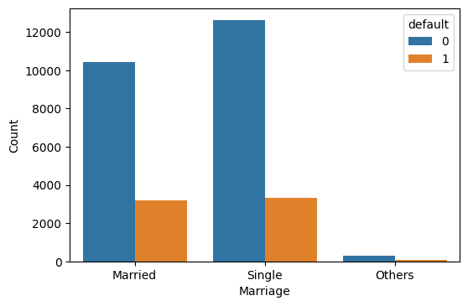
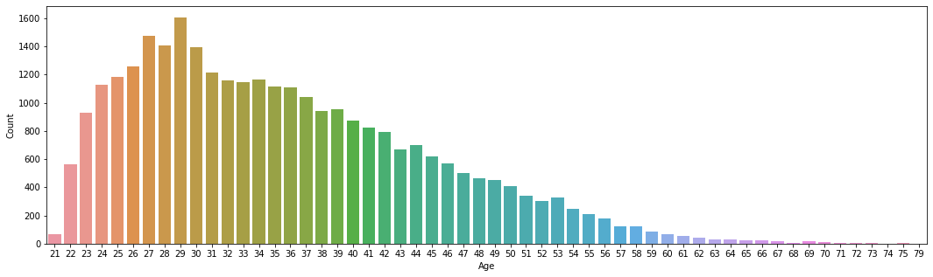
While there is more number of Single customers using credit card the defaulter are of same ratio among the married and single customer's. The non defaulter ratio is high among the single customer’s .
The credit card users are mainly between
the age group of 27-32.

Slide 6
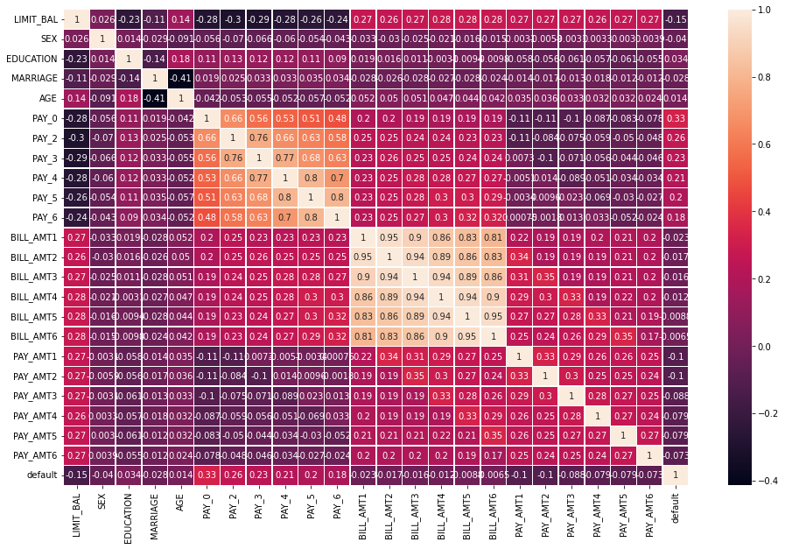
Here we can see that the PAY_0, PAY_X variables are the strongest predictors of default,
followed by the LIMIT_BAL and PAY_AMT_X variables.

Slide 7
Algorithms Used
Logistic Regression
KNN
Decision Tree
Random Forest
Naïve Bayes

Slide 8
The KNN algorithm is showing a better accuracy among the lot on training dataset followed by Random forest and decision tree.
Demographics: we see that being Female, More educated, Single and between 30-40years old means
a customer is more likely to make payments on time.

